Slide 1
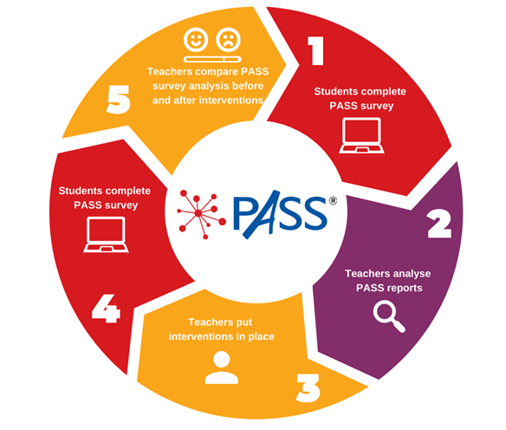
PASS is a powerful tool because it measures the impact our school climate and culture is having on the development of our children. It tells us how our school climate and culture are making our children feel about themselves as learners and individuals.
GL PASS Surveys are used to sensitively explore the social and emotional wellbeing of our students.
These individual surveys allow us to intervene and provide guidance swiftly and effectively to the students who need it most.

Slide 3
Malachi are a not for profit, therapeutic family support organisation founded in 1991, working across the Midlands and Staffordshire. We support parents/carers, young people and professionals through a range of counselling based therapeutic interventions to create lasting change.
Through our range of services in school, home and the community we help families see a better future, believe it is attainable, and choose to make it happen.

Slide 5
Reading
NGRT Reading Age Testing
Dedicated Library Lessons
Form Tutor Reading Programme
Reading across the curriculum

Slide 6
Sports clubs
Debate and writing clubs
Musical Theatre Productions

